Slide 1
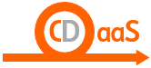
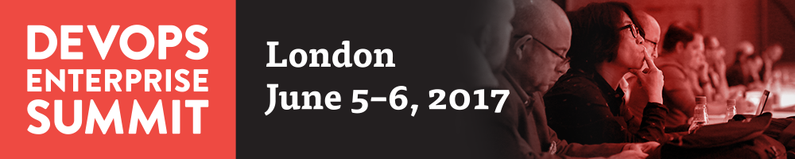
Global Continuous Delivery in a Financial Organization
Daniele Romano, PhD
Global Product Owner Continuous Delivery as a Service

Slide 2

From 2012 to 2016 through the ING Continuous Delivery Journey

Slide 3

In 2012 Agile and Scrum were already our religion

Slide 4
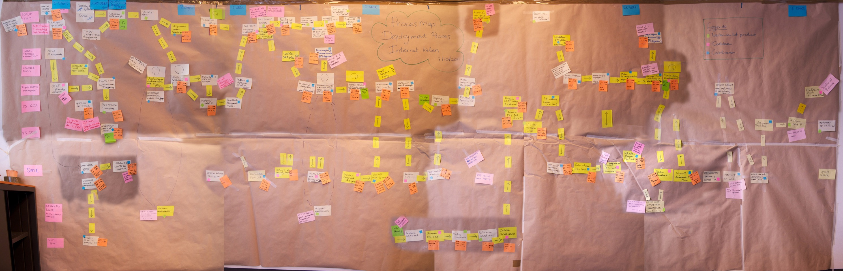
Long Release Process
And Time to Market

Slide 5
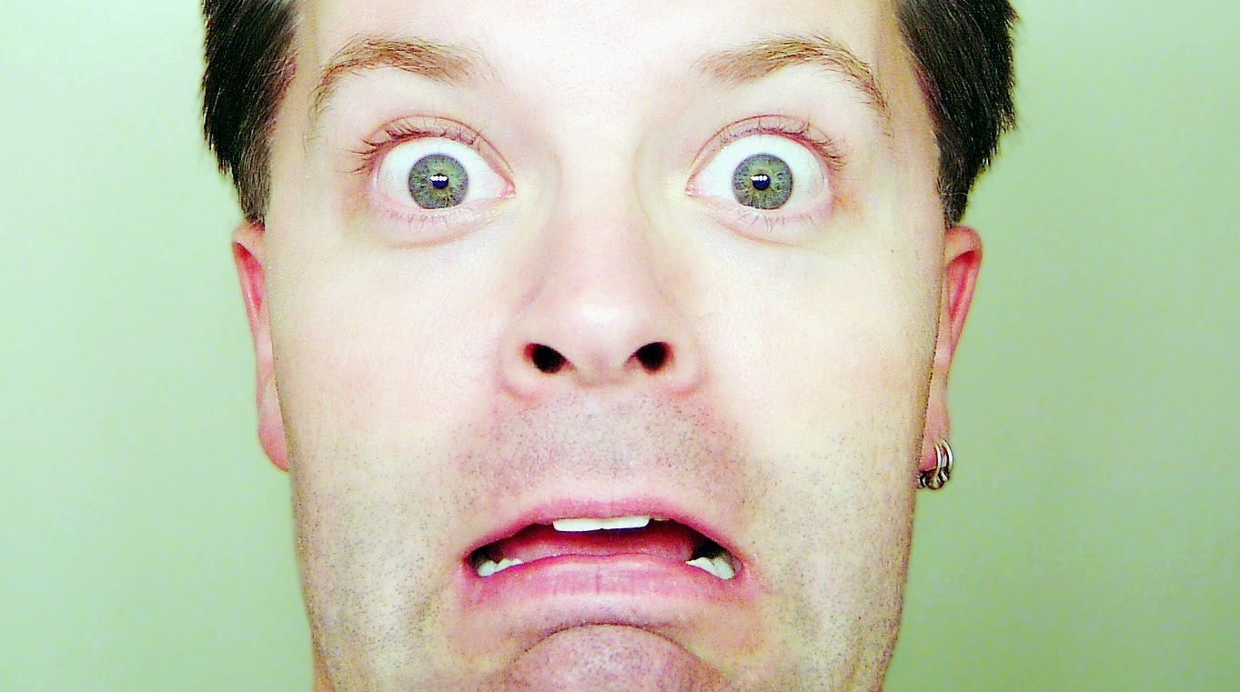
Afraid to Release

Slide 6

Late Night Bug Fixing

Slide 7
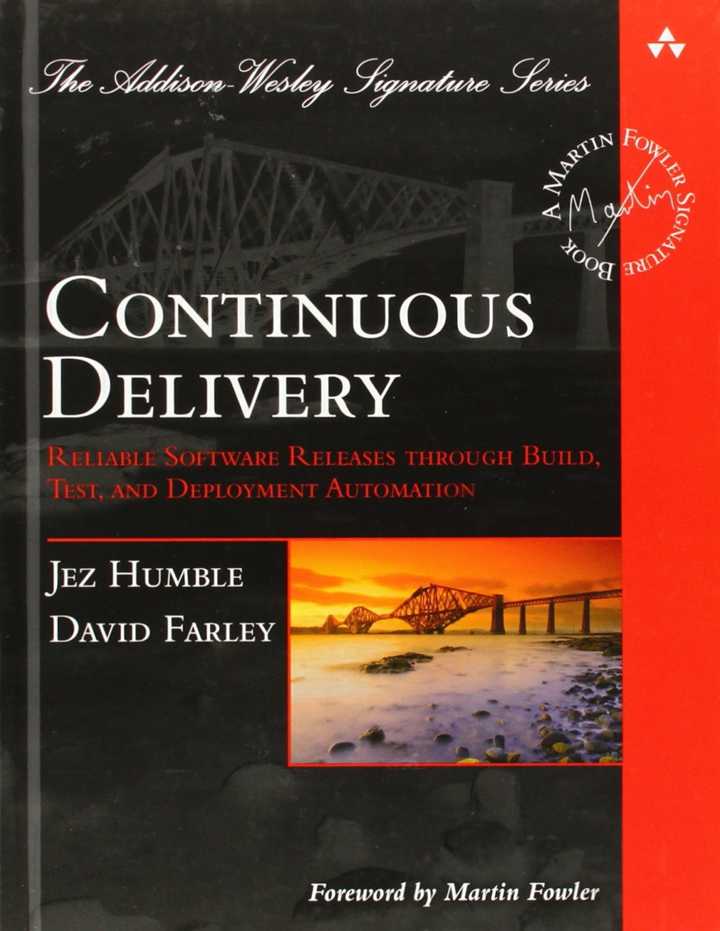
Our journey started with THE book

Slide 8
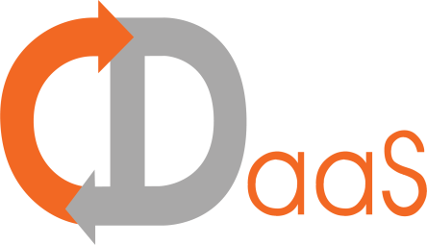
Why Continuous Delivery?
We had two main goals:
being a manufacturing-like production line that automates ideally all the steps that brings the code to production reducing the cycle-time in delivering valuable software
enabling the teams to ensure the compliancy, quality, and the value of software systems
Automation
Quality

Slide 9
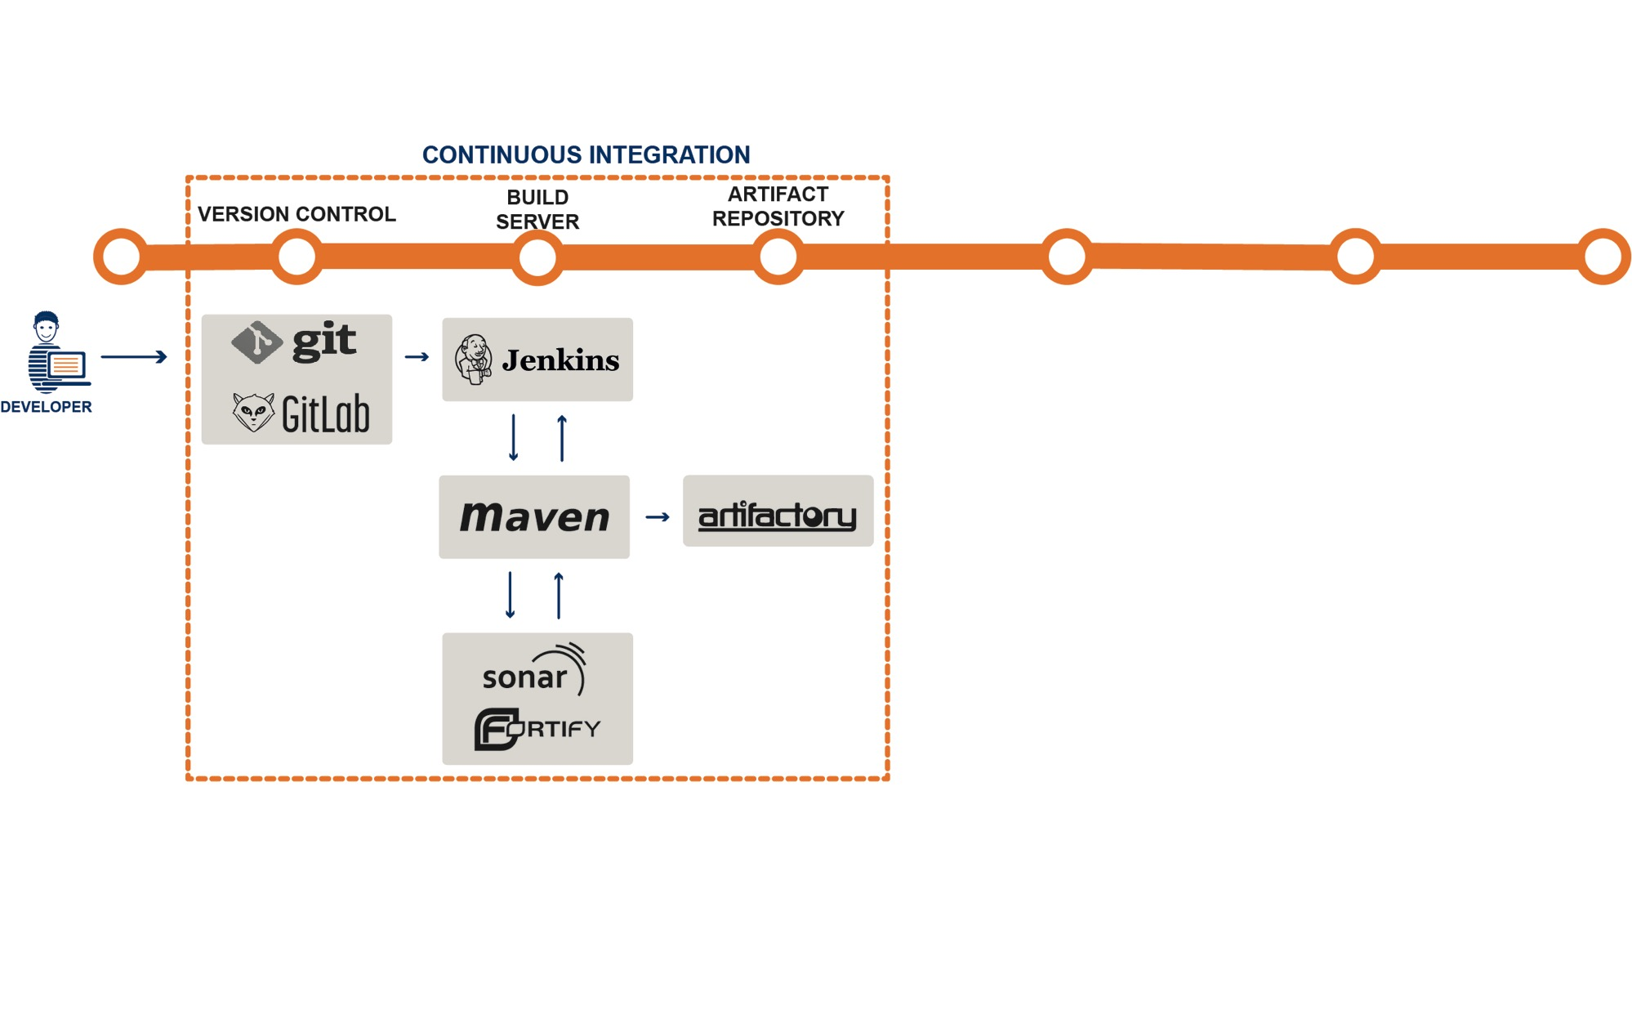
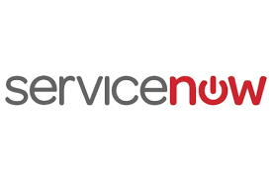
It starts with Continuous Integration…

Slide 10
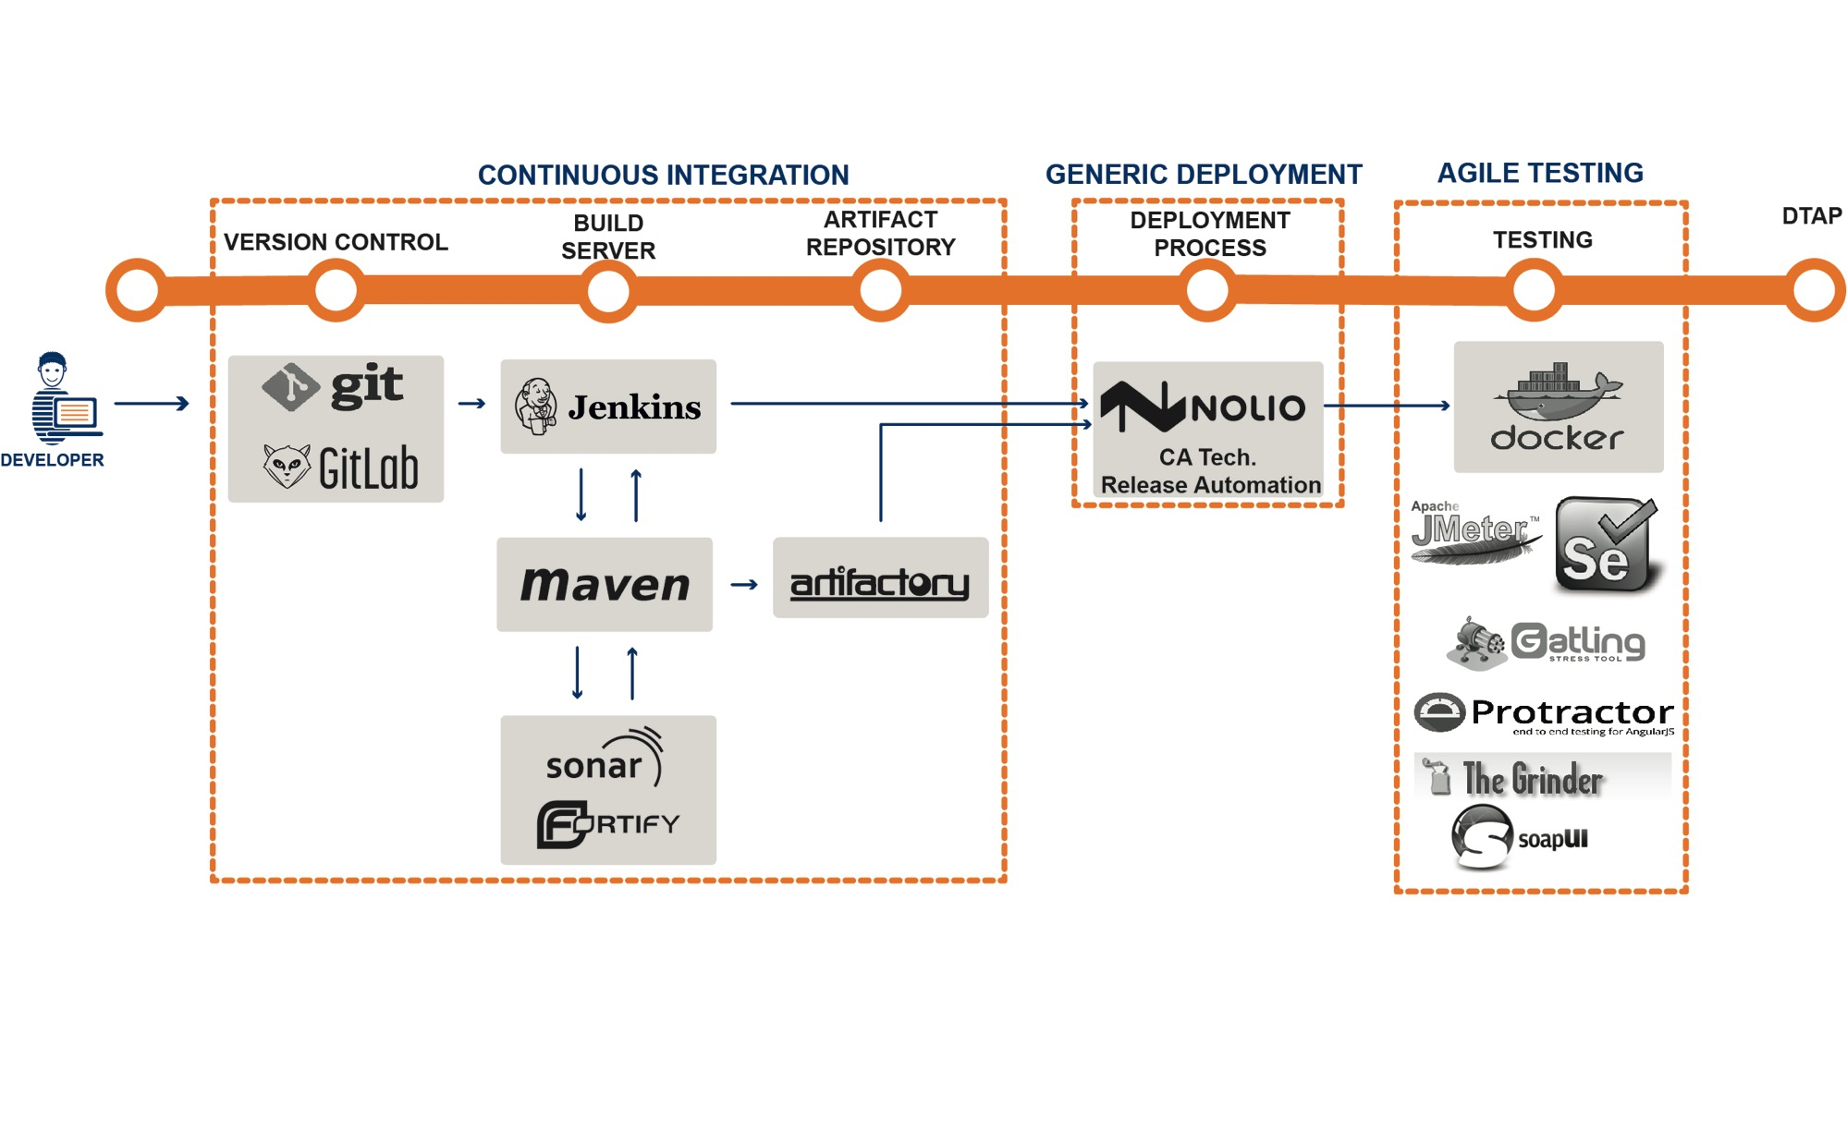
…and automated
Deployment and Testing
CA Release Automation

Slide 11
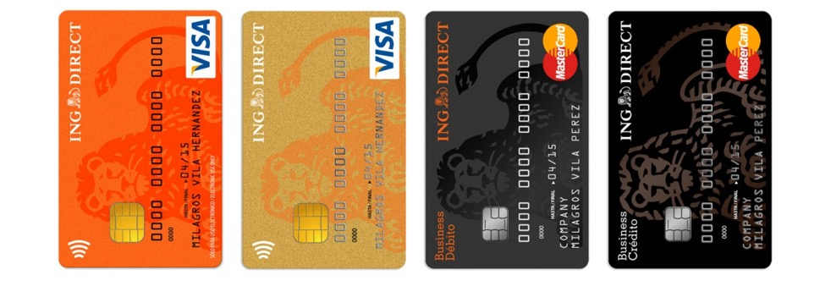
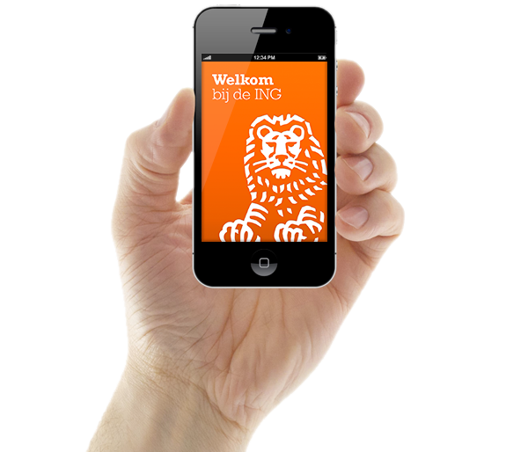
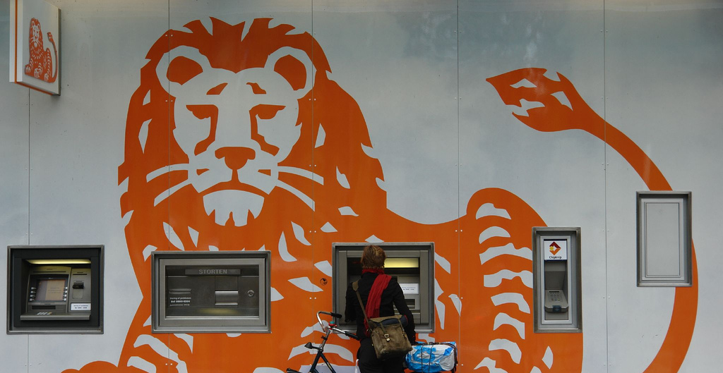
> 740 application going through one pipeline to our customers

Slide 12

Management still unhappy about Time to Market
and Quality

Slide 13
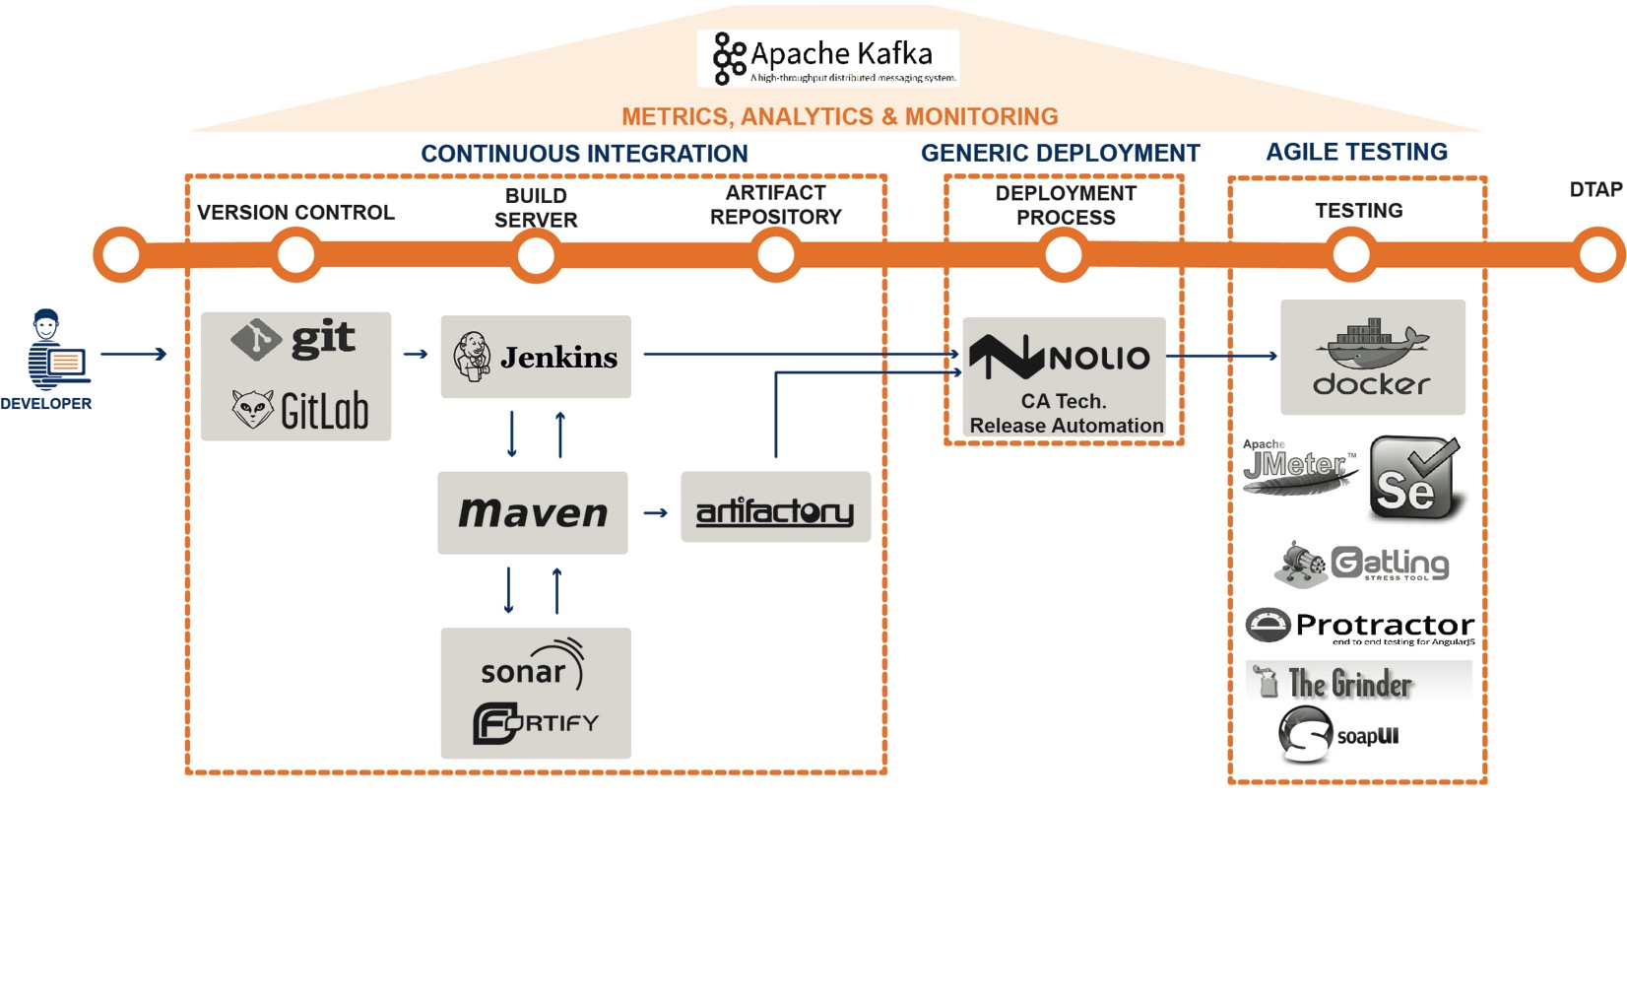
Monitoring and
Analytics
CA Release Automation

Slide 14
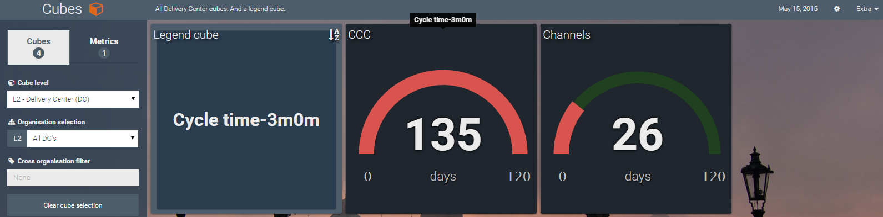
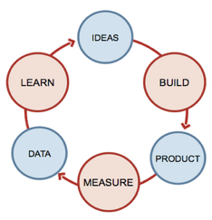


Around 50 metrics used to improve the process through scientific approach
With Scientists

Slide 15
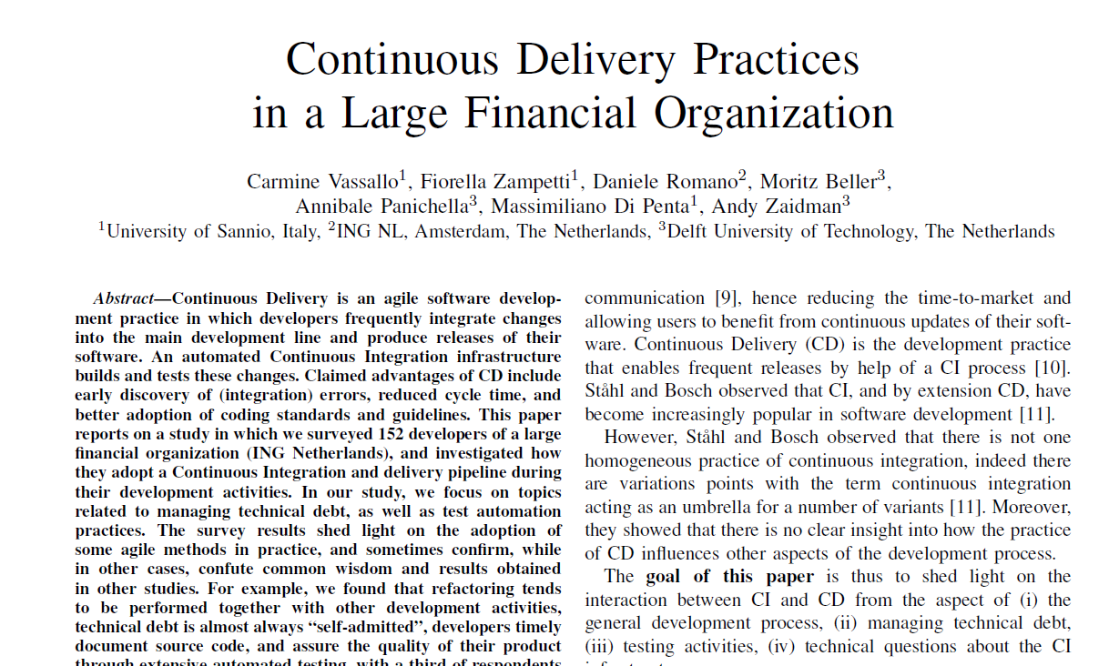

Slide 16
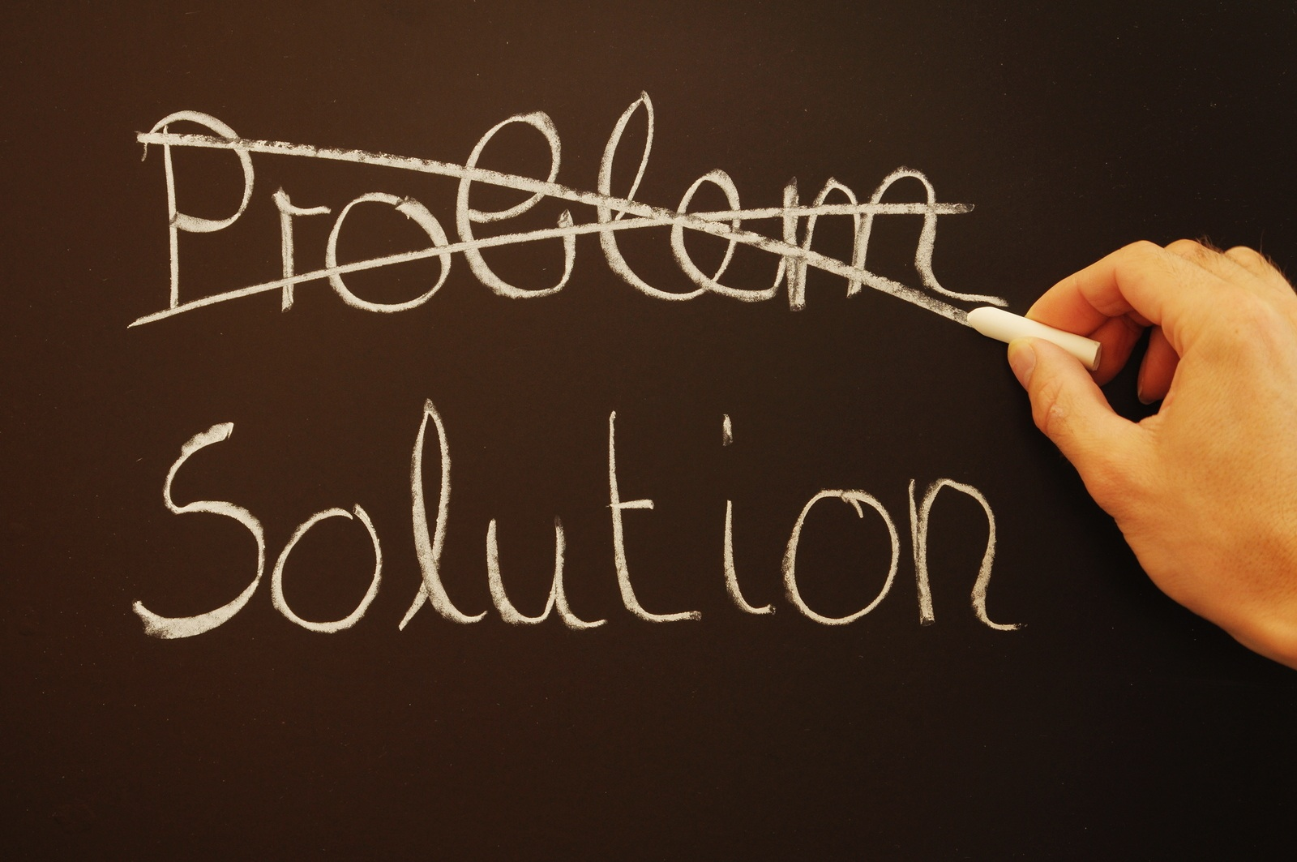
Cultural innovation
Devops journey
Compliancy

Slide 17

Cultural Innovation Management
Portfolio Management improvement – Decision Making
Removal of bottleneck-teams through backlog mining

Slide 18

Cultural Innovation Product Owner
Give room for Continuous Improvement
Smaller releases actionable for customers

Slide 19
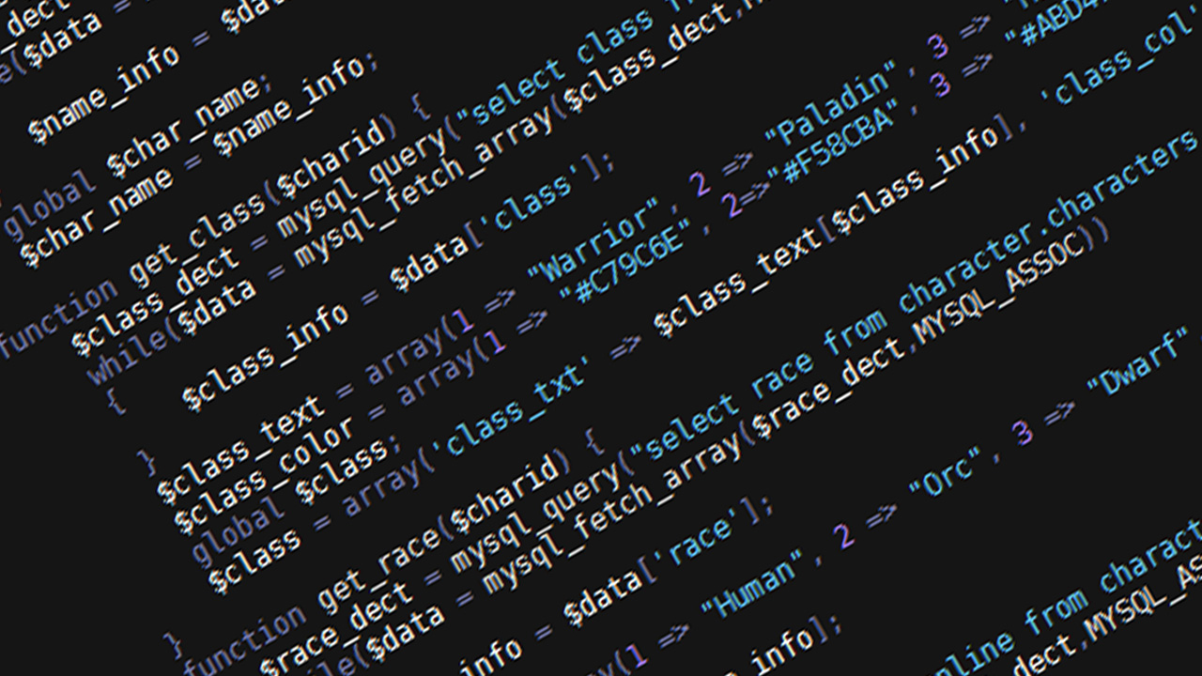
Cultural Innovation Engineers
Integrate continuously your change
Push your changes as far as you don’t detect problems
Shift-left all quality checks
Fix issues as soon as they appear

Slide 20
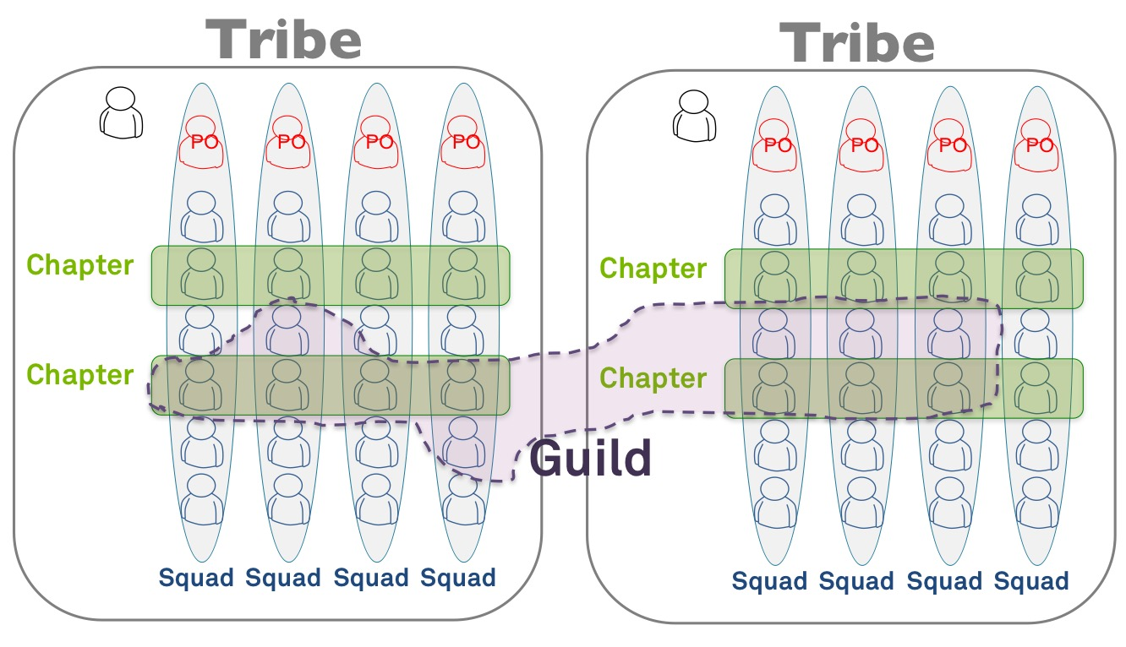
Spotify Model
PO with IT background
Business in the tribe

Slide 21
Cultural Innovation
Continuous Delivery as a Service
CA Release Automation
One opinionated flow as shared service for all the teams

Slide 22
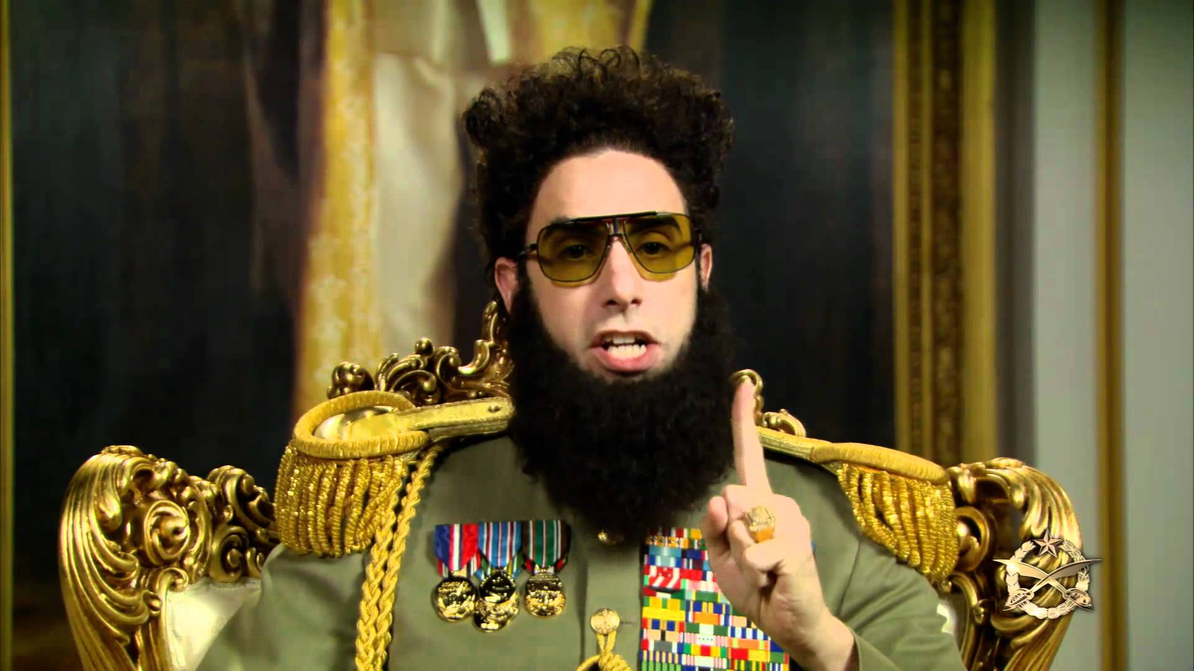
Concept Of One
without enforcement

Slide 23

Concept Of One With communities
Front-end platform team
API platform team
Scala platform team
.NET platform team
COTS platform team
TIBCO platform team

Slide 24
DevOps Journey EverythingAsCode
Using CDaaS teams create blueprints describing:
A domain (e.g., CDaaS)
The systems that are part of the domains (e.g., Gitlab, Artifactory, BuildServer, APIs)
Input and Output connections allowed to and from the domain
Full composition of an individual system: #instances, CPUs, MEM, Storage, OS, etc.
From Deployment to Assembly

Slide 25

Compliancy

Slide 26

Compliancy
The CDaaS assembles the artefacts from Artifactory based on the blueprint into immutable servers and deployed in the domain described in the blueprints.
Benefits of immutable server patterns
Better control of IT Risk footprint:
It’s impossible to access the machine after deployment (read-only)
Some controls are not needed anymore
Redefinition of our policy house based on the outcome over imposition principle
No need for SEM-I
No need for technical state compliancy monitoring

Slide 27
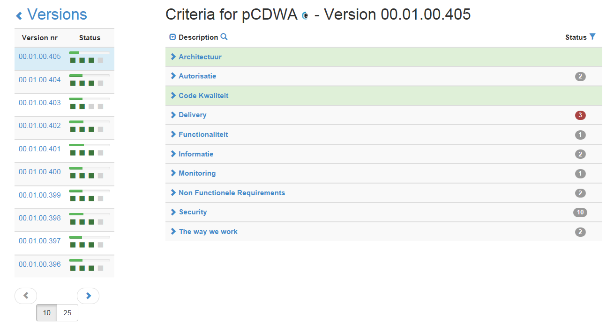
Compliancy
Automated tollgate

Slide 28

Going to production takes minutes/hours
Considerable reliability improvements
Relaxed atmosphere on the floor

Slide 29
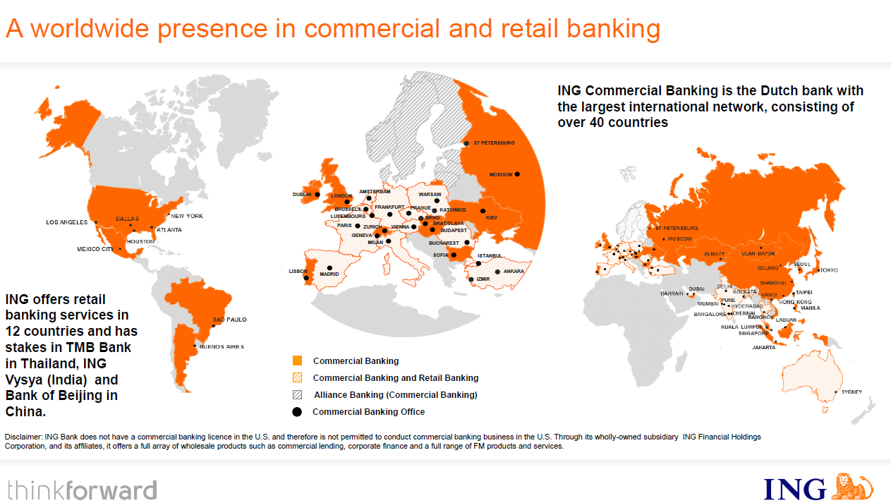
Global Continuous Delivery Journey

Slide 30
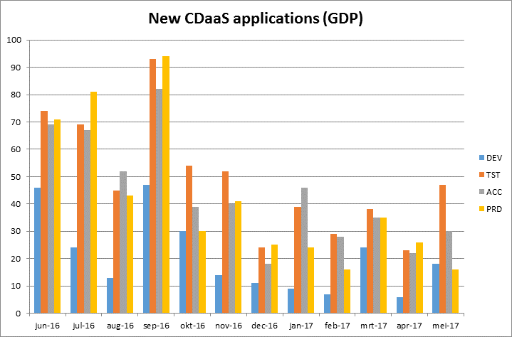
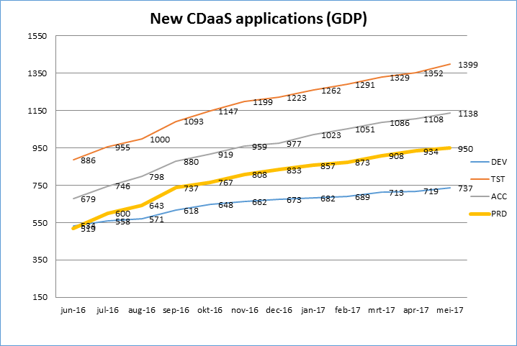
The Global Usage of CDaaS
Applications using the Generic Deployment Process through CA Release Automation
±700 teams using CDaaS globally

Slide 31
